Slide 1


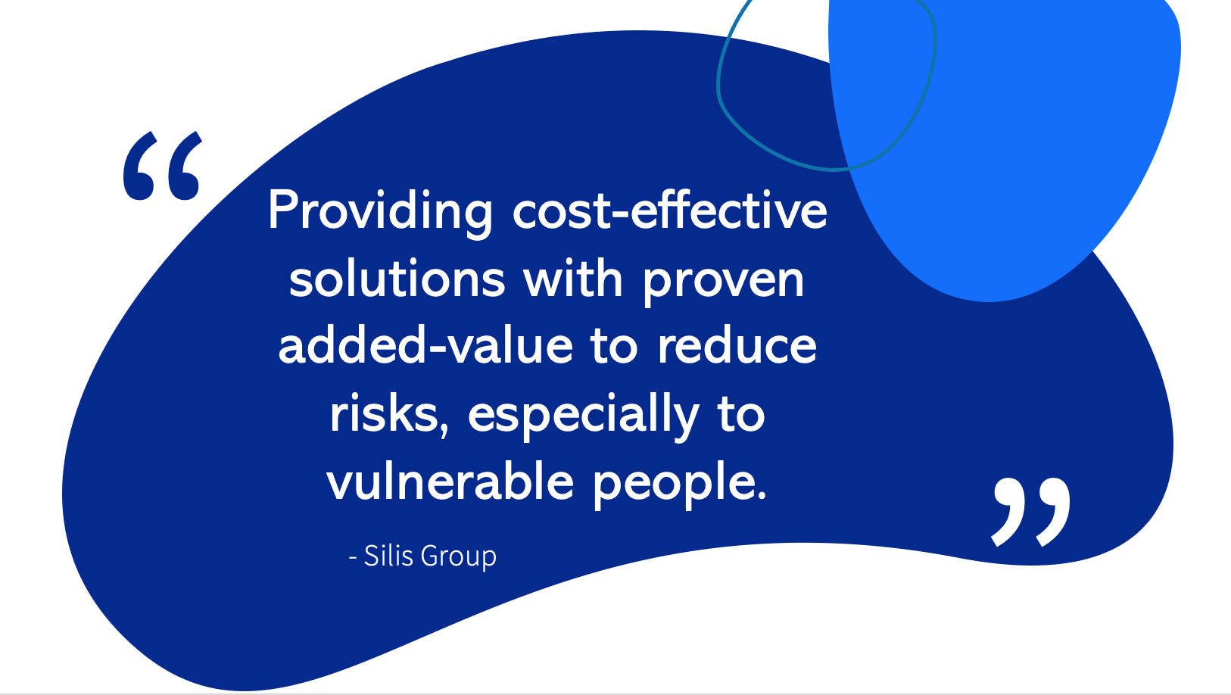
An introduction to Silis Group
John Rees
Managing Director

Slide 2



Who are Silis Group?
Enhancing Healthcare with Technology
About Silis Group
Origins
Our Goals
Specialise in R&D with a primary focus on the healthcare and care sectors
Pioneering technical solutions for vulnerable individuals
Inspired by John Rees’ hospital observation: Sparse usage of hand sanitising stations due to malfunctions or lack of consumable
This sparked an initiative for a transformative solution
To pinpoint and improve situations using our simple, cost-effective technology
To streamline costs for organisations while amplifying their efficiency
To elevate user experience and mitigate healthcare-associated risks

Slide 3



Silis Group’s Two Brands:
Skylis offers clever solutions for improving hygiene efficiency and reducing waste across all sectors, whereas Smilis uses technology to provide comprehensive and personalised care for vulnerable individuals such as vocal reminders, fall alarms, unusual behaviour alerts, and access control. This presentation will deal primarily with Skylis technology.

Slide 4

Purpose
Applications
Benefits
Extensions
To combat hospital-acquired infections using advanced technology
To monitor dispenser usage and volumes
To improve facility cleaning and maintenance efficiency
Encourages hand sanitisation across the board - for the public, healthcare professionals, cleaners, and more
Targets healthcare environments and care homes
Reduces the spread of infections responsible for nearly 30,000 UK deaths
Economical, simple to set up, adaptable to any dispenser
Provides real-time data, dispenser auditing, customer feedback, cleaning protocols, staff training modules and janitor alerts
Increases efficiency, enhances company image, optimises staffing and consumables
Applicable for hygiene in public washrooms; stock checking, customer feedback, and more
Applicable for hygiene in all public or corporate washrooms, stock control, and more; with Skylis, there will never be an excuse for empty dispensers again!

Slide 5

The HAI problem
70% of healthcare-acquired infections (HAIs) caused by poor hand hygiene
1 in 10 patients acquires an HAI annually in the UK, in the world 1 in 10 people acquiring a HAI die
Consequences in the UK:
Annual death toll: 28,500
Prolonged hospital stays: 10-25 extra days
Significant cost to the NHS: £5 billion each year every year

Slide 6
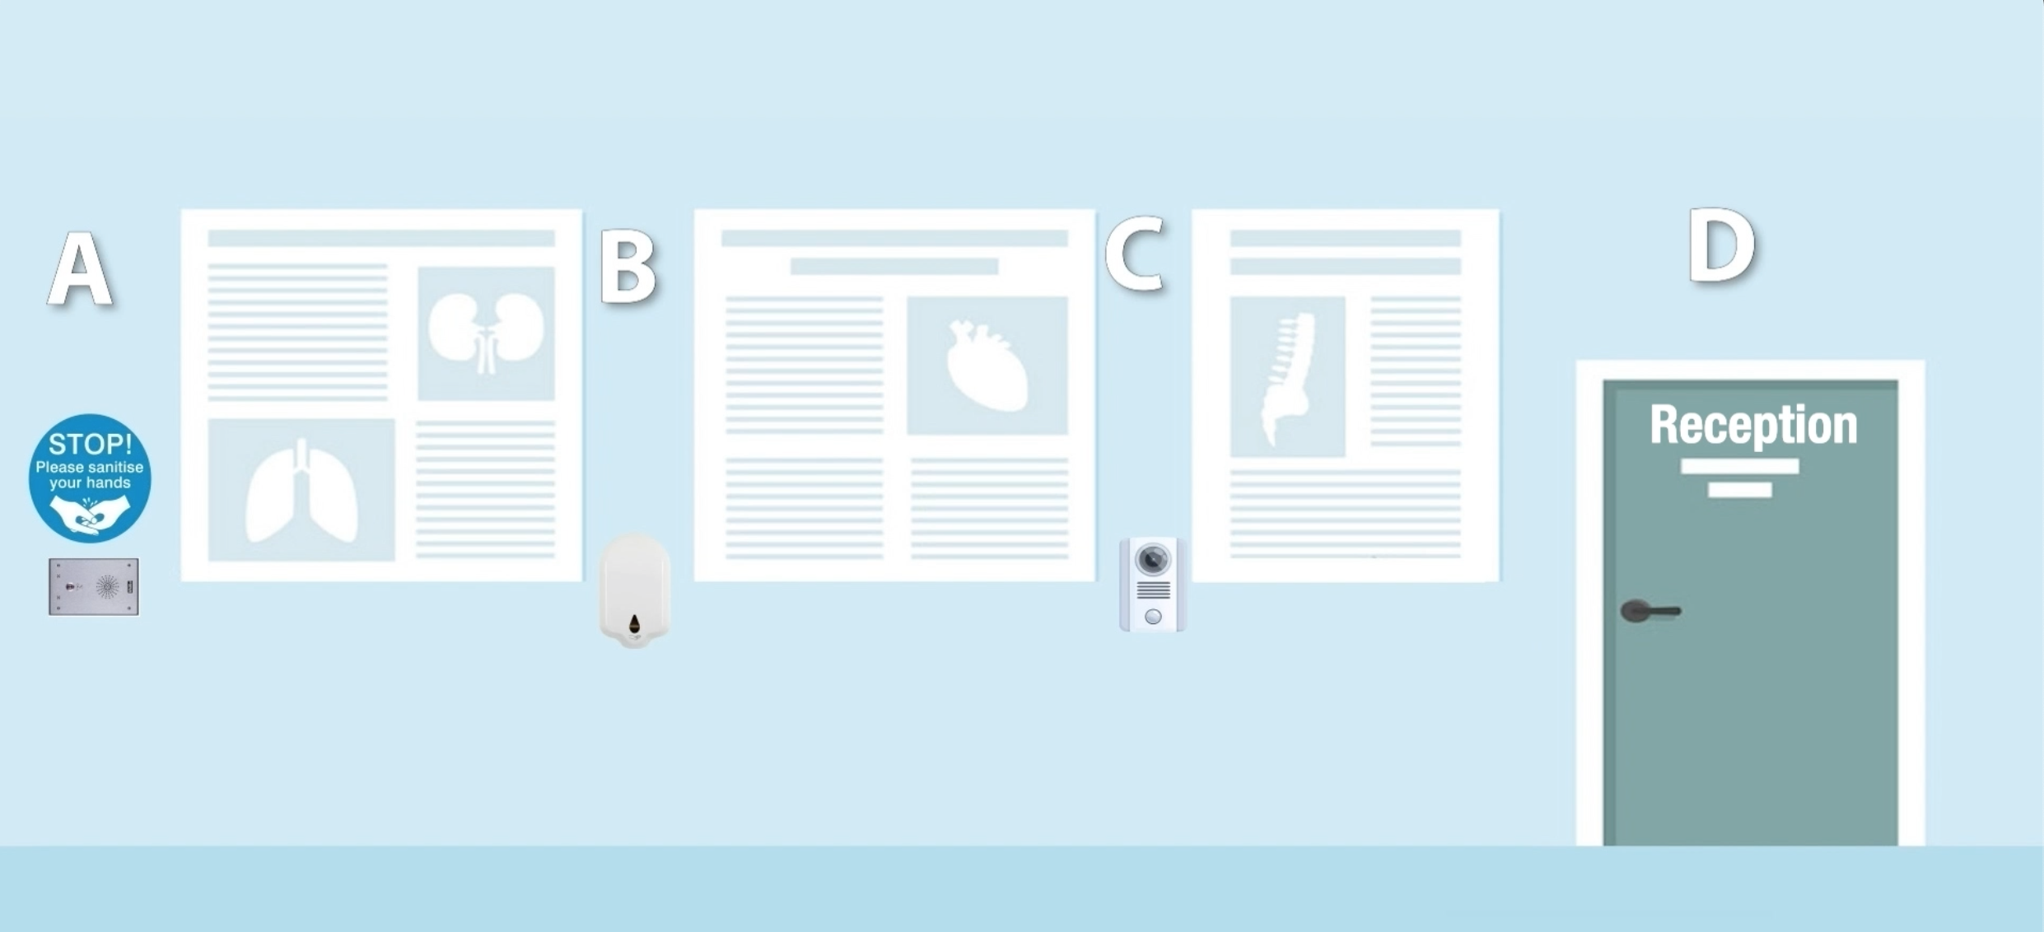
The Smart Dispenser
A Game-Changer for Healthcare Hygiene
Purpose
Designed for high traffic areas like care homes and hospitals to combat the spread of infections
How it works:
A. Alert speaker
Positioned on a wall, it notifies individuals passing by to sanitise their hands
B. Automatic Sanitiser
A hands-free unit fixed on the wall ensuring minimal contact and maximum hygiene
C. Usage Tracker
Smart Dispenser registers the sanitiser's use. If by-passed, a second speaker prompts the individual to return and sanitise their hands. Usage can be recorded either privately and/or publicly.

Slide 7
The Smart Dispenser: Tracking and Data
Data Collection & Alerts:
Data Collection & Alerts: Tracks and records sanitiser usage in real-time
Receptionists can monitor individuals' sanitising habits
Instant notifications via red (non-compliance) and green (compliance) LED lights help receptionists take action
The Smart Dispenser isn't just a sanitising unit; it's a holistic system ensuring everyone passing the dispenser uses it, thereby maintaining basic hygiene standards, and reducing the spread of healthcare-acquired infections

Slide 8
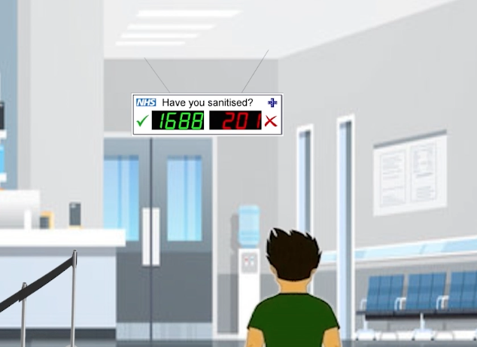
Overhead monitor
Boosting Hand
Sanitising Compliance
A mnemonic aid to hand hygiene awareness and compliance. Tests have shown a minimum usage in compliance over 50% with a simple light above the dispenser. Skylis goes much further.
D
R
E
A
M
Dispenser
Reminding
Encouraging
and
Monitoring
Purpose
Works in tandem with our Smart Dispenser to further motivate visitors to maintain hand hygiene upon entry and exit of healthcare premises
Notes:
https://www.youtube.com/watch?v=9YGThuUEMic

Slide 9
Overhead Monitor: The User Journey
Information Boards
Sentinel Speaker
Smart Dispenser
Overhead Monitor:
Placed at entrance points
Visual reminders about the importance of hand sanitising to prevent HAIs spread
Optional but recommended for greater compliance
Detects a visitor's presence and gives vocal prompt: "Please sanitise your hands."
Monitors hand sanitisation actions
Ensures real-time tracking of hygiene compliance
Displays real-time feedback
Green counter: indicates successful sanitisation. Red counter: indicates missed sanitisation opportunities
With Skylis Overhead Monitor, visitors receive constant reinforcement of hand hygiene importance,
leading to better habits and ultimately a safer healthcare environment.

Slide 10

Washroom monitor
Placement and purpose
Washrooms Benefits for Maintenance Staff:
1.Real-Time Monitoring
Ideal for public washrooms or within office spaces
Primary function: to monitor dispenser levels in public building wash-rooms and avoid empty or dysfunctional dispensers
Accurately view the content level of each dispenser
Eliminate guesswork and unnecessary checks
2. Efficiency
Swiftly identify which dispensers need attention
Ensure consistent availability of essential supplies
3. Cost-Effective
Minimise wastage by replacing only what's needed
Optimise manpower and resources

Slide 11
Upcoming Slides
Dive deeper with
screenshots showcasing:
Washroom Monitor's display
Highlighted key functions for enhanced user experience

Slide 12
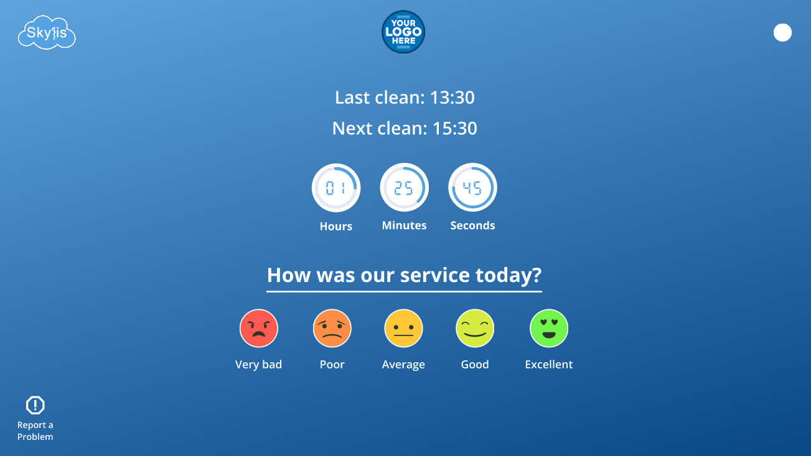
Monitor Home Screen
The home screen will be what washroom visitors will see upon entering/exiting the washroom the monitor is connected to
Time of last and next clean
Button for Admin/Janitor login
Customer Feedback emojis
Report a Problem

Slide 13
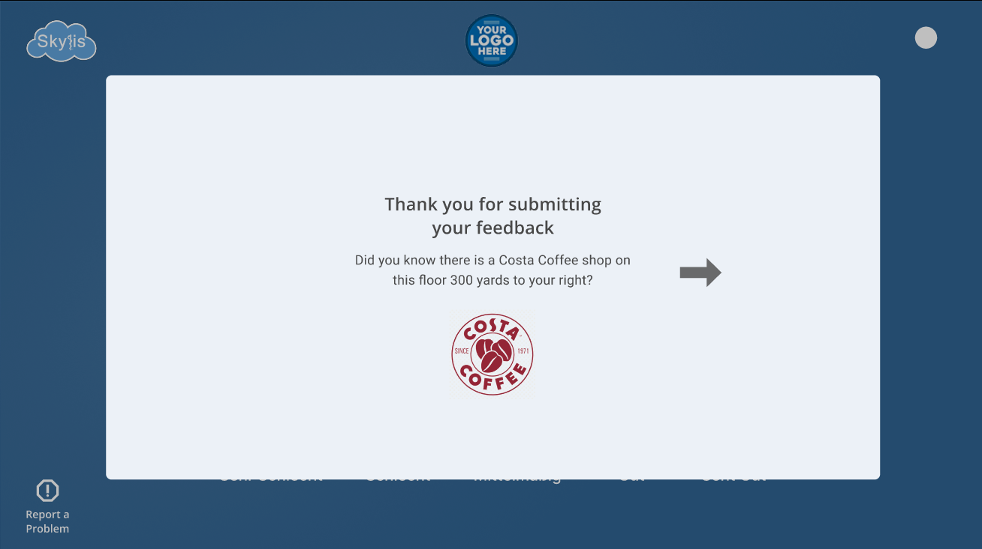
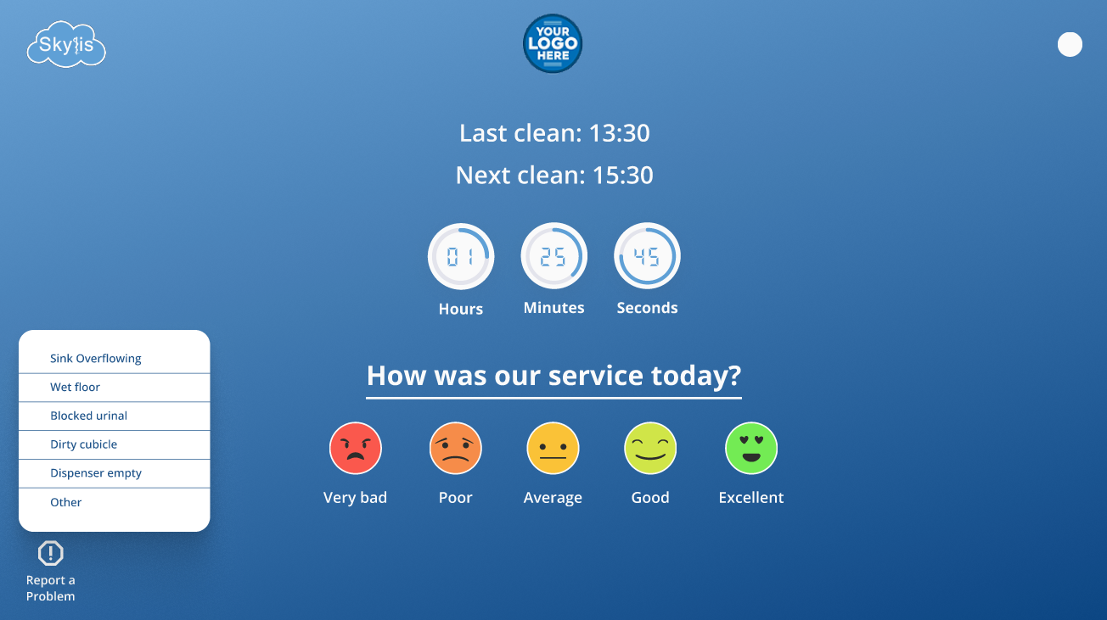
Visitor Interaction
Option for a pop-up ad or message after Customer Feedback is engaged (advertising can more than cover the cost!)
Visitor can report a problem in the washroom

Slide 14
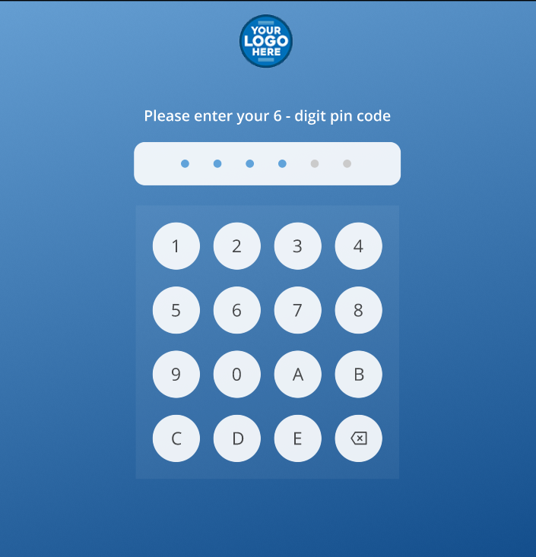
Admin/Janitor Login
Login keypad to access data

Slide 15
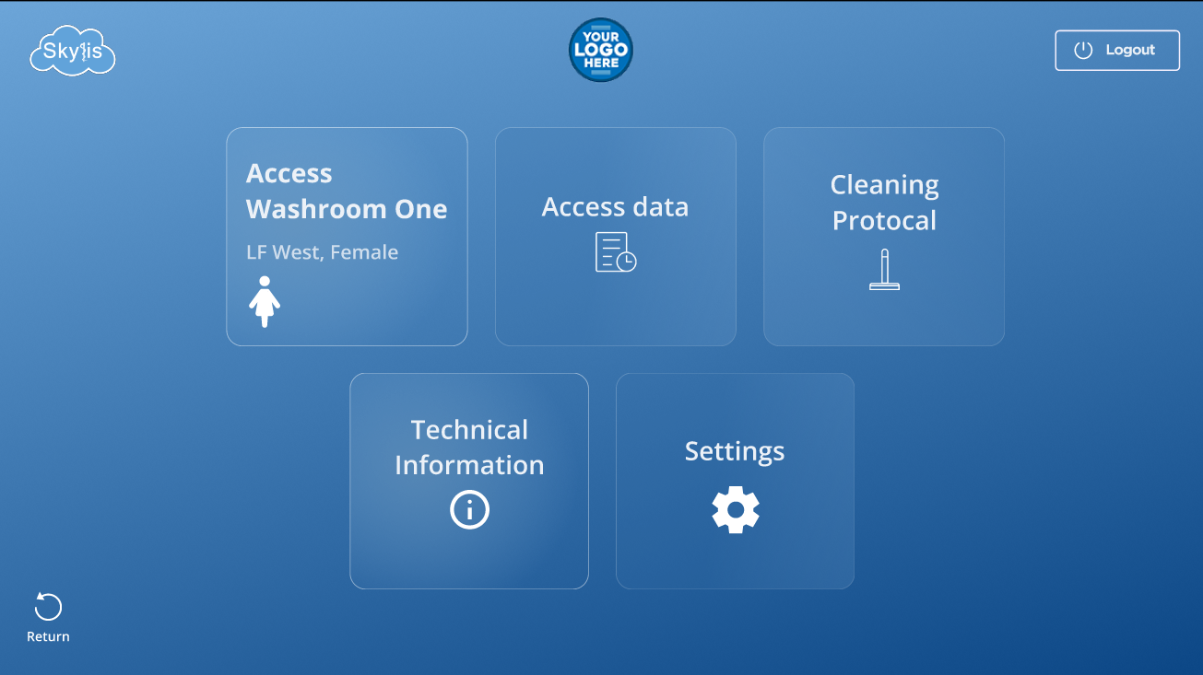
Main menu
Access Washroom
Access data
Cleaning Protocol
Technical Information
Settings

Slide 16
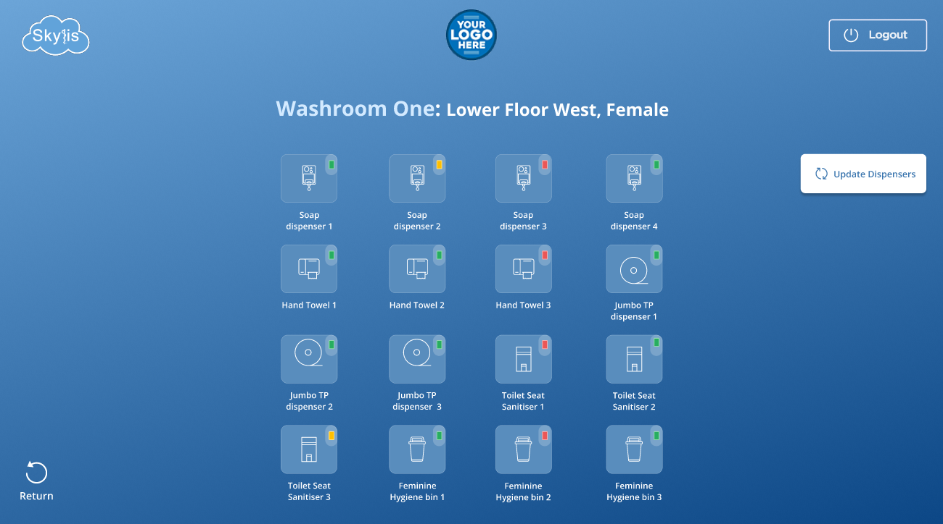
Washroom
View dispenser levels with the traffic light system:
Dispenser level fine
Dispenser due for refill
Dispenser needs refilling
Update Dispensers:
Button access the option to select a dispenser on display and update it to Green (full) once it has been refilled

Slide 17
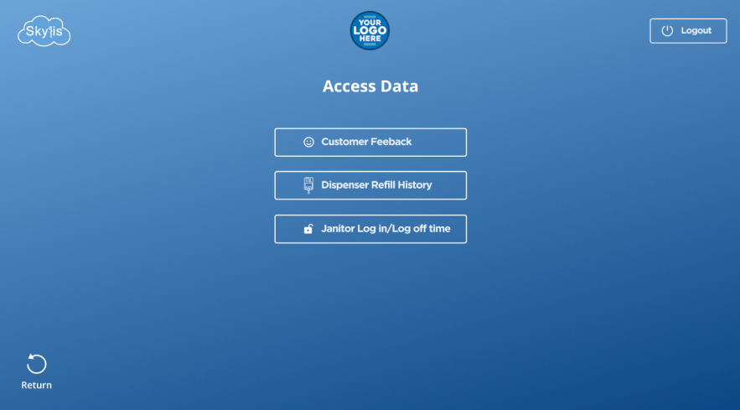
Access data
Customer feedback
View the data charts for the Customer Feedback buttons on the Home screen
Send and save the data for specific dates
Dispenser Refill History
View the data for the time and dates each specific dispenser was changed
Send and save the data for specific dates
Janitor/Log in/Loff Time
View the data for each individual who has admin access to the monitor
Send and save the data for specific dates

Slide 18
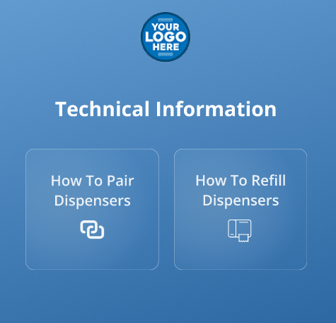
Technical Information
This page consists of a menu that acts as a guide page for administrators with access to the monitor. The help guide can either be illustrated as a ‘How To’ video or ‘How to’ written guide.
The examples on this screen:
How To Pair Dispensers
How To Refill Dispensers

Slide 19
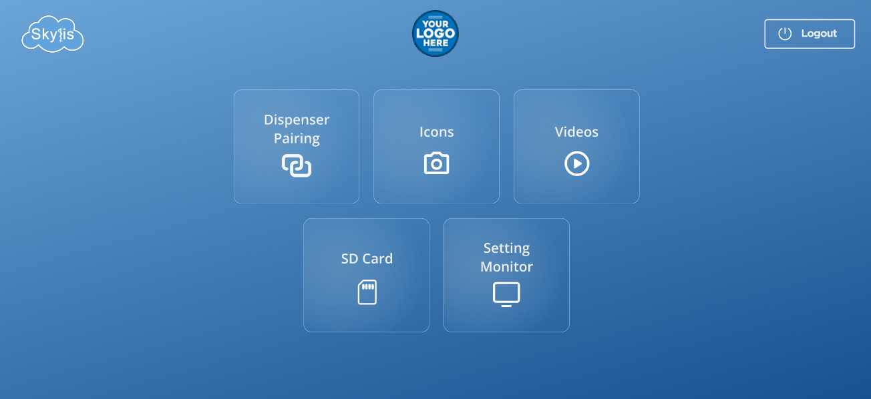
Settings
Enhancing Healthcare with Technology
The screen example below consists of:

Slide 20
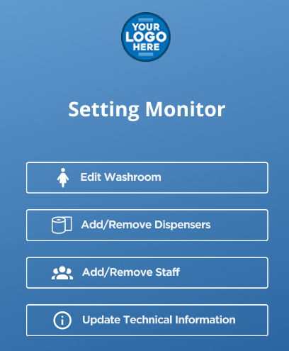
Settings
Enhancing Healthcare with Technology
Settings monitor:
The Setting Monitor page allows for functional edits and changes on the monitor
Dispenser Pairing:
Every individual dispenser that is installed to monitor can be paired from a transmitter to receiver to enable level monitoring
Icons:
The icons used in the monitor as displays can be uploaded, changed and edited
Videos:
The videos used to demonstrate guides can be uploaded, changed and edited
SD card:
An SD card can be inserted into the monitor and its capacity information can be found here.
Through this medium, the administrator can easily update or modify additional information specific to the organisation. One SD card slot is included; a second slot is available as an option.

Slide 21
Settings
Enhancing Healthcare with Technology
The example below shows:
1. Edit Washroom:
Edit the name of Washroom your monitor is connected to
2. Add/Remove Dispensers:
Should dispensers be removed or added in the washroom, they can be updated here
3. Add/Remove staff:
Add or remove admin access and provide a pin code for access
4. Update Technical Information:
The Technical Information page can have guides removed or new guides uploaded

Slide 22
Summary of options and benefits
Displays time of next cleaning event
Displays time of last cleaning event
Janitor log on and log off using PIN code (No need for expensive ID cards)
Washroom user feedback counters
Can advise specific tasks and cleaning protocols via SD card
Monitors and displays levels in soap, sanitizer, paper towels, sanitary towel dispensers
Monitors and displays up to 8 individual dispensers (option for >32)
Dispenser levels are displayed as a percentage
Low percentage warnings can be set by customer
Monitors and Displays up to 16 individual Dispensers (option for >32)

Slide 23
Summary of options and benefits
Can operate with and without Cloud Server Technology
Can display graphic or photograph of washroom and location of dispensers.
Any number of percentage warnings can be set
Times of dispenser top ups or cartridge changes are monitored with Janitor's ID
Multiple levels of PIN Codes can be set. e.g. Janitor/ Supervisor/ Manager
Displays last (7) days events
SD Card Slot
Can show loading diagrams or videos
Fully programmable using Graphic User Interface ( GUI) – For use in Hospitals and Care Homes

Slide 24
Summary of options and benefits
Displays periodic dispenser activity
Displays periodic janitor activity
Monitors and records waste of consumables (if changed too early)
Communicates with remote devices (server, smart phone, computer)
Monitors and displays Toilet Cubicle usage
Can monitor and display number of people who do and do not use a dispenser – helps increase hygiene levels
Sponsorship possible on monitor
Advertising on screen via SD card (extra SD card slot)
Janitor log on and log off using QR Code
LoRa Comms Device fitted

Slide 25

Skylis Monitor Patent
Silis has made patent applications for all its technology in the UK, USA, and Europe, of which some have already been granted.

Slide 26



Thank you
Thank you for your attention. As a final point, please be aware that all our technology is cost-effective with fast returns on investment. End-user customers can benefit from the technology on a service rental agreement. Our radio transmission technology is retro-fittable to 99.99% of all dispensers within seconds, has no requirement for cloud-based services unless required which means no extra periodic costs; the devices allow for free choice of the suppliers of consumables. Sponsorship and advertisement deals further contribute to reducing or even eliminating the costs.
John Rees
Matthew Thomas
Andrew Cawthorne
Managing Director
Media Director
Sales Director

